Slide 1
House price prediction – Machine learning foundation project
Sunil Kumar Mano
GCD - June '08 batch, INSAID
Email : sunilkumarm.182@gmail.com

Slide 2
Introduction
A house value is simply more than location and square footage. A client wants to find their next dream home with a reasonable price tag. They have their locations of interest ready. Now, they want to know if the house price matches the house value. With this study, they can understand which features (ex. Number of bathrooms, location, etc.) influence the final price of the house. If all matches, they can ensure that they are getting a fair price.
We are going to take advantage of all of the feature variables available to use and use it to analyze and predict house prices. We are going to break everything into logical steps that allow us to ensure the cleanest, most realistic data and build a machine learning model to make accurate predictions.

Slide 3
Exploratory data analysis
It is important to deploy descriptive and graphical statistics to look for potential problems, patterns, classifications, correlations and comparisons in the dataset. In addition, data categorization (i.e. qualitative vs quantitative) is also important to understand and select the correct hypothesis test or data model.
We have 1460 observations of 81 variables in the dataset.
SalePrice - the property's sale price in dollars. This is the target variable that we are trying to predict.

Slide 4
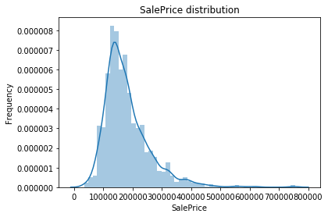
Distribution of Target variable
From the visualization we can able to understand that target variable sale price is not normally distributed and it is right skewed.

Slide 5
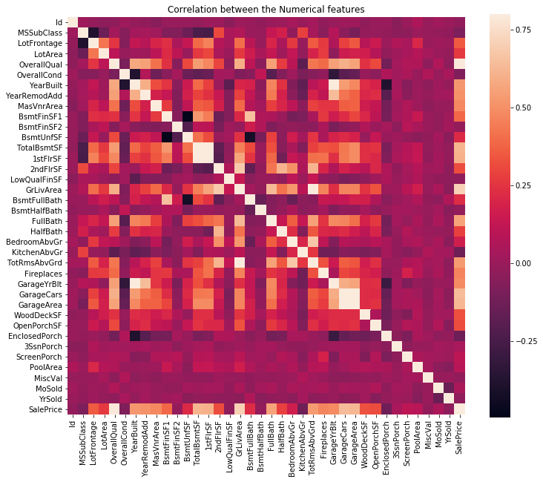
Correlation of numerical features
Well, the most correlated features to Sale Price is...
OverallQual: Rates the overall material and finish of the house
GrLivArea: Above grade (ground) living area square feet
GarageCars: Size of garage in car capacity
GarageArea: Size of garage in square feet
YearBuilt: Original construction date

Slide 6
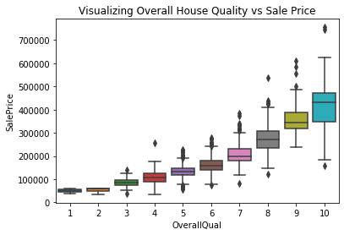
Visualizing House Quality vs Sale Price
From the visualization we can able to understand that the Sale price of the house increases with increase in house quality with little amount of outliers present.

Slide 7
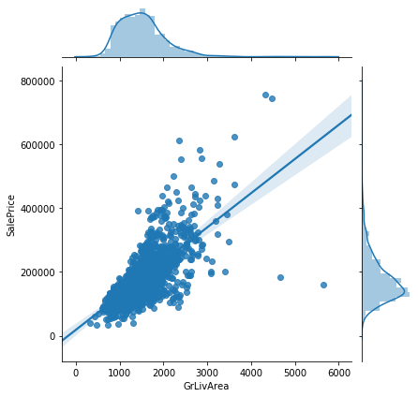
Visualizing Living Area vs Sale Price
From the visualization we can able to understand that the Sale price of the house increases with increase in Living area with little amount of outliers present. The values are not normally distributed at it is skewed.

Slide 8
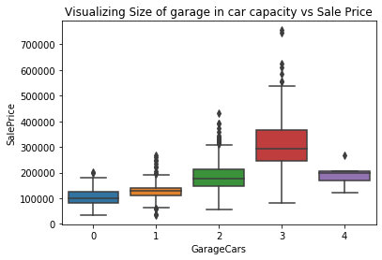
Size of garage in car capacity vs Sale Price
From the visualization we can able to understand that the Sale price of the house increases with increase in size of garage in car capacity up to an extent with little amount of outliers present.

Slide 9
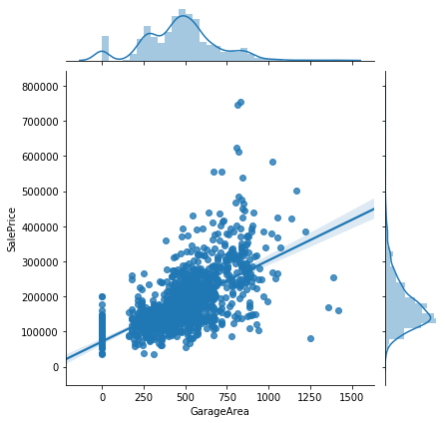
Size of garage in square feet vs Sale Price
From the visualization we can able to understand that the Sale price of the house increases with increase in size of garage in square feet with little amount of outliers present. The values are not normally distributed at it is skewed.

Slide 10
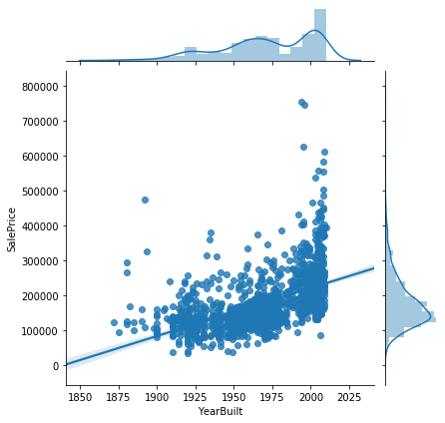
Visualizing construction date vs Sale Price
From the visualization we can able to understand that the Sale price of the house increases when the construction date of house is in recent years. The values are not normally distributed at it is skewed.

Slide 11
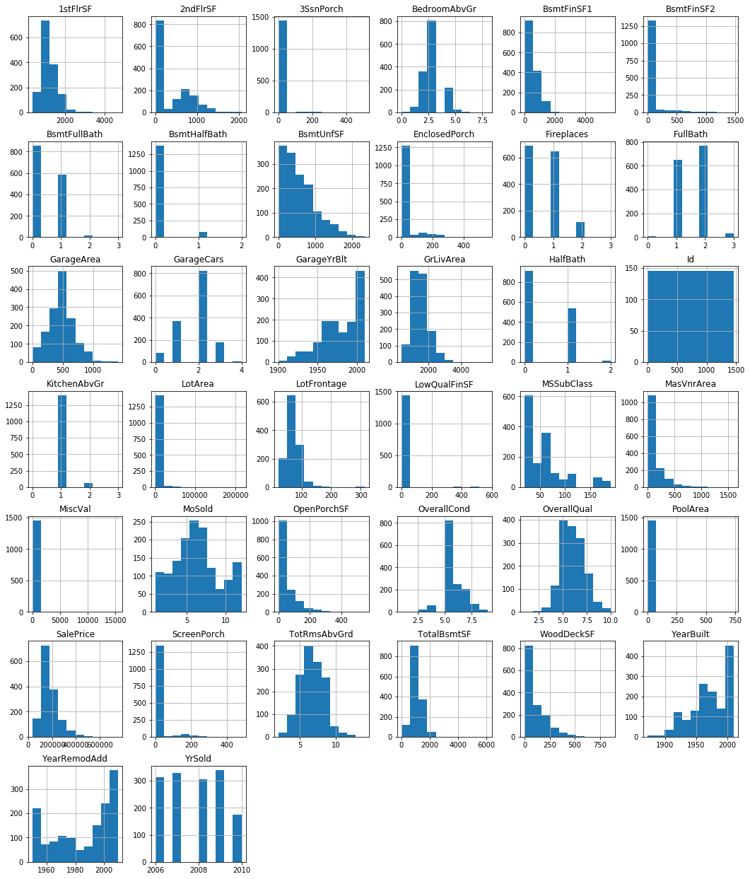
distribution of Numerical features
From the visualization we can able to understand that numerical features are not normally distributed and it has to be scaled to make it to distribute normally. So, let’s find out the missing values in the data and fix it and then we can scale the dataset.

Slide 12
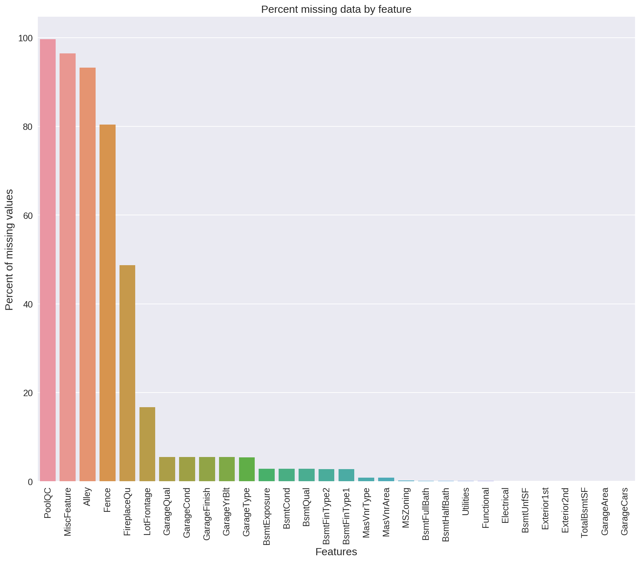
Percentage of missing data by feature
From the visualization we can able to understand that 5 features have more than 50 percent of missing data and we are going to drop those columns. Rest of the columns with missing data, we are going to fix it by using the statistical techniques Mean, Median and Mode.

Slide 13
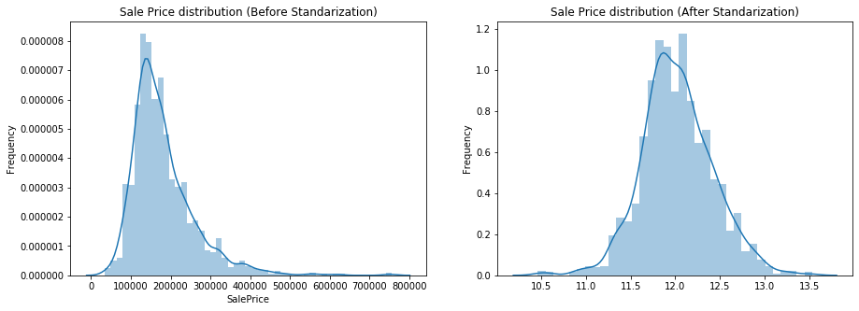
Sale price distribution after standardization

Slide 14
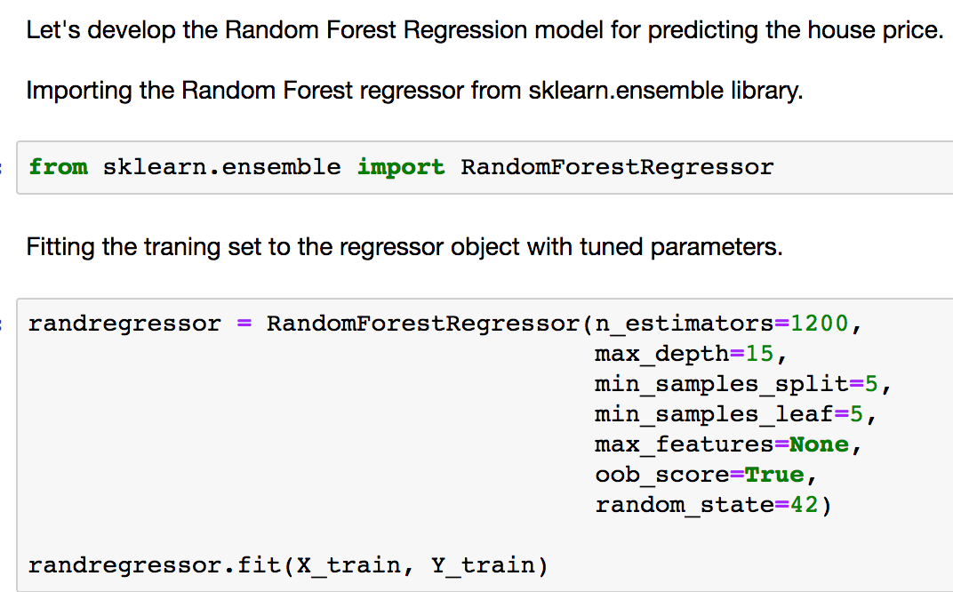
Model development – Random Forest

Slide 15
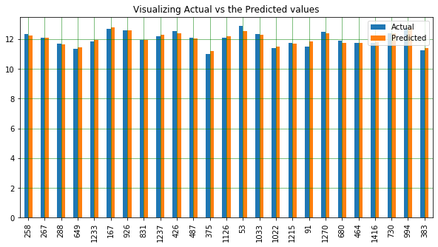
Visualizing the Actual and Predicted values
From the visualization we can able to understand that our Random Forest Regressor has predicted the values more accurately.

Slide 16
Conclusion
Based on our evaluations, we can conclude that Random Forest Regressor is the best model for predicting the house price. Random Forest Regressor has,
Less Mean Absolute error
Less Mean Squared error
Less Root Mean Squared error and
R2 score closer to 1
Hence, for future predictions, if the client provides the parameters to our model for predicting the house price, our Random Forest Regressor will provide the reasonable price for the house.

